Slide 1
Margaret Wise Brown
Diandre Decaro
Chelsey Toner

Slide 2
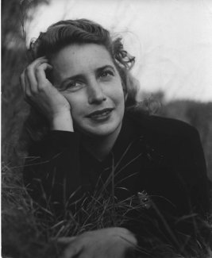
Biography
Born on May 23, 1910 and died at the age of 42 from a bursting appendix.
She grew up in New York before she moved to Maine.
Her first book was published in 1937, “When the Wind Blew.”
To keep from flooding the market with her name, she used other pen names.

Slide 3
Biography
She wrote over a 100 books in a short amount of time
She wrote all the time, often dreaming stories and writing them down in the morning before she forgot them
Margaret’s friends say she was a creative genius who made a room come to life with excitement
She saw herself as a write of songs and nonsense

Slide 4
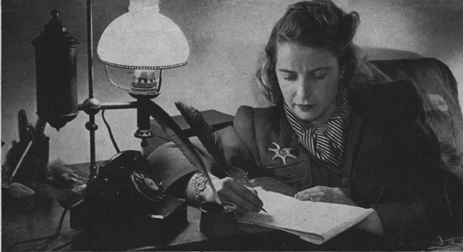
Writing Trends
Most of the characters in her books were animals and she liked to write books that had a rhythm to them.
Margaret tried to write her books the way that children wanted to hear them and had illustrators draw the way that the children saw things.

Slide 5
Writing Trends
She would try to use a hard word in her stories or poems to make the children think harder.
Most of her illustrations were painted with bright and vibrant colors.
She used simple language.
All of her books had a different illustrator

Slide 6
References
http://www.margaretwisebrown.com/Her_books.html
http://www.margaretwisebrown.com/long_bio.htm

Slide 7
Lesson Plan
Focus/Review:
  Today we are going to read a book about friendship and discuss the differences that some friends may have.
Objective:
  The students will share who is their best friend, how they met, and their similarities and differences.
Teacher Input:
  First we will discuss what the children already know about friendships:
    What are friends?
    What makes a good friend?
  Next I will have all of the students find their place on the carpet and read the book, The Golden Egg Book.
  After I finish reading we will then discuss the similarities and differences that friends may consist of:
  Friends can be the same or different colors, size, age, and gender.
  I will then put them in pairs and have them begin their guided practice activity

Slide 8
Lesson Plan
Guided Practice:
  In partners the students will tell each other about their best friends:
    How did they meet their best friend?
    Is their best friend the same, gender, race, age, and size?
    How long they have been friends for.
Independent Practice
  For homework the students will write in their journals about their best friend.
    Is your best friend the same gender, race, age, and size as you?
    What qualities make them a best friend: caring, loving, funny, can keep secrets…ect
    How long have you been best friends for?
    Does your best friend live in the same state/town/country as you?
    Are you related to your best friend?
Assessment/Closure
  I will wrap the lesson up with an informal assessment.
  I will ask the class who wants to share their journals about their best friends.

